Slide 1
Multinomial Logistic Regression
Regression Analysis and Non-Linear Models: Sociology 6100
Dr. Matsuo

Slide 2
Multinomial Logistic Regression is used when the DV has 3 or more categories.
e.g. Survey outcome (Excellent, fair, complications)
Frequency of experience of discrimination (Always,
often, sometime, rarely, never)
IVs can be categorical and/or continuous.

Slide 3
Example of DV (campus climate survey)
Case Processing Summary
 |  | N | Marginal Percentage
Felt discriminated because of race | Never | 782 | 85.1%
 | Once | 46 | 5.0%
 | A few times | 39 | 4.2%
 | Occasionally | 22 | 2.4%
 | Often | 30 | 3.3%
White non-white | White | 225 | 24.5%
 | Non-White | 694 | 75.5%
Valid |  | 919 | 100.0%
Missing |  | 65
Total |  | 984
Subpopulation |  | 2

Slide 4
Coefficient Table (white=2)
Parameter Estimates
Felt discriminated because of raceª |  | B | Std. Error | Wald | df | Sig. | Exp(B) | 95% Confidence Interval for Exp(B)
 |  |  |  |  |  |  |  | Lower Bound | Upper Bound
Once | Intercept | -3.030 | .187 | 262.758 | 1 | .000
 | [whitenon=1,00] | .721 | .322 | 5.020 | 1 | .025 | 2.057 | 1.095 | 3.866
 | [whitenon=2,00] | 0^{b} | . | . | 0 | . | . | . | .
A few times | Intercept | -3.296 | .212 | 240.916 | 1 | .000
 | [whitenon=1,00] | .987 | .337 | 8.561 | 1 | .003 | 2.683 | 1.385 | 5.198
 | [whitenon=2,00] | 0^{b} | . | . | 0 | . | . | . | .
Occasionally | Intercept | -4.129 | .319 | 167.764 | 1 | .000
 | [whitenon=1,00] | 1.532 | .437 | 12.282 | 1 | .000 | 4.629 | 1.965 | 10.904
 | [whitenon=2,00] | 0^{b} | . | . | 0 | . | . | . | .
Often | Intercept | -4.129 | .319 | 167.764 | 1 | .000
 | [whitenon=1,00] | 2.043 | .397 | 26.449 | 1 | .000 | 7.714 | 3.541 | 16.805
 | [whitenon=2,00] | 0^{b} | . | . | 0 | . | . | . | .
a. The reference category is: Never.

Slide 5

Equations
DV: Categorical variable (3 ore more categories)
IV: Categorical variables + covariate
j=1, 2……J-1
If DV has J categories, j^{th} category is used as a reference category
There will be J-1 equations
(SPSS automatically specifies the last category as a reference category.)

Slide 6


Equations (cont.)
e.g. Patient’s condition after surgery
DV: 1= Excellent
2=Normal
3=Complication

Slide 7

Interaction Effects
e.g. DV: Condition after surgery
IV: Sex (Male=1, Female=0)
Education (Categorical)
Age
Main Effect Model

Slide 8
Interaction Effects (cont.)
Main Effect Model plus Interaction Effect of Sex and Age

Slide 9


Interaction Effects (cont.)
Saturated Model: All main effects and all possible interaction effects with the highest order

Slide 10

Third Pairwise Comparison
Complication was a reference category, but you want to compare Excellent against Normal.
Log (a/b) = log (a) – log (b)
OR
Recode the DV so that the category, Normal, will become a reference category.

Slide 11
Predicted Probabilities
P(j^{th} category) = O_{j} / (1+ O_{j)}
E.g. Estimated Logit O_{Excellent}
P_{Excellent} = O_{Excellent} / (1+ O_{Excellent})

Slide 12
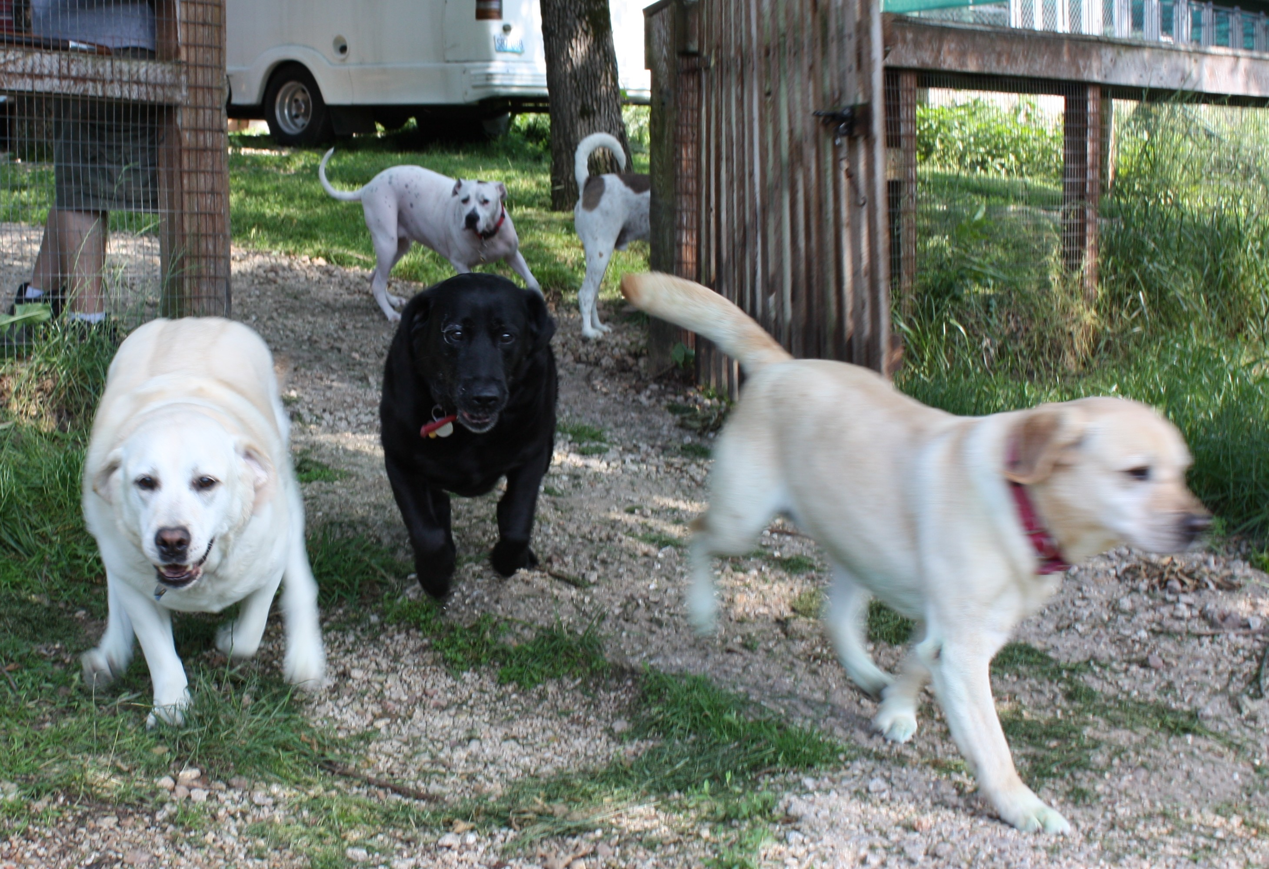
Let’s take a look at the output file!

